Slide 1

SGEMM GPU KERNEL PERFORMANCE
k.Sathwika

Slide 2
INTRODUCTION
This paper proposes a novel approach for the prediction of computation time of kernel's performance for a specific system which consists of a CPU along with a GPU (Graphical processing unit). The prediction is done based on 14 different configurations of processor such as local work group size, local memory shape, kernel loop unrolling factor, vector widths for loading and storing etc. A proposed system accomplished with multiple regression algorithms and regularization like Linear Regression for making the predictions. Finally, the performance of the proposed system for predicting the running time of processors has the accuracy of 99.3% after using feature reduction techniques

Slide 3
OverView
t looks like you're describing a dataset that records the running times of a matrix-matrix multiplication operation (A * B = C) on a GPU, using a parameterizable SGEMM kernel. Here’s a clearer, rephrased version:-The dataset provides measurements of the running time for a matrix-matrix multiplication operation \(A * B = C\), where all matrices are 2048 x 2048 in size. The running times are obtained using a parameterizable SGEMM GPU kernel, with a total of 241,600 feasible parameter combinations out of 1,327,104 possible combinations. Each of the 241,600 feasible combinations was tested four times, and the results are recorded in the last four columns of the dataset. The kernel parameters are divided into 14 variables: the first 10 are ordinal, taking up to four different powers-of-two values, while the remaining 4 variables are binary. All times are measured in milliseconds.

Slide 4
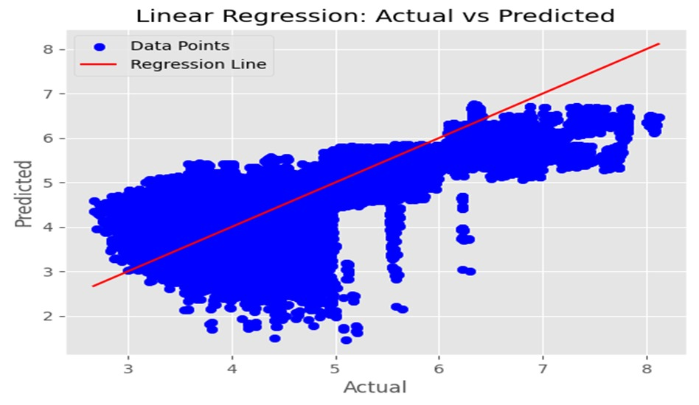

Slide 5
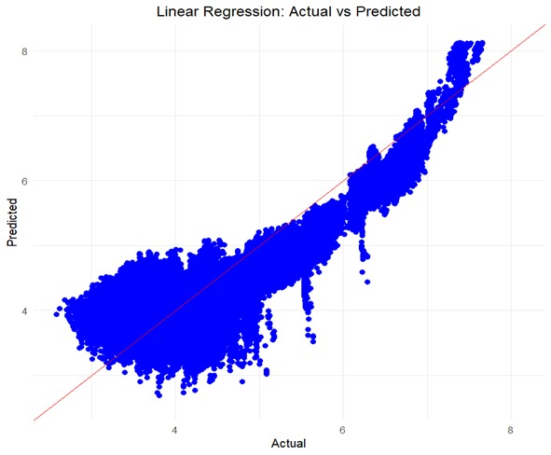

Slide 6
Values: MSE = 0.294735591954632MAE = 0.452727555479866RMSE = 0.542895562658815 R-square value = 0.555023334728897Adjusted R-square = 0.5549201688215724

